Slide 1
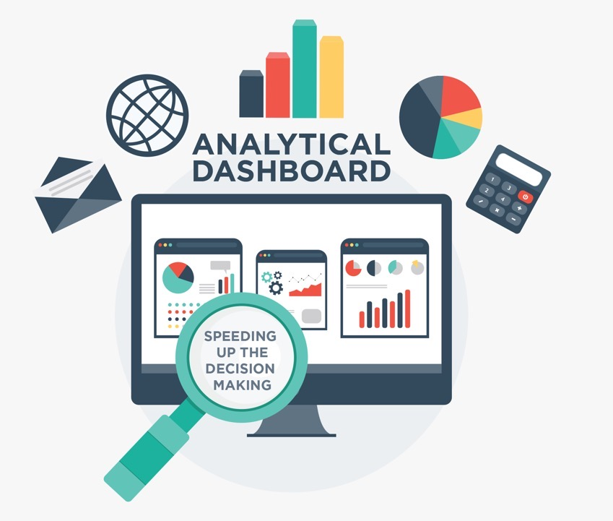
Query Processing in Data Warehouse
MCO1

Slide 2
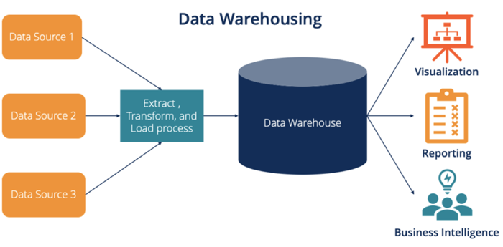

Slide 3
MCO1 Tasks
Build the Data Warehouse
  Design the dimensional model
  Determine the dimensional hierarchy
  Build the database schema
Setup the ETL Pipeline
  Determine the data for extraction
  Determine the data transformation
  Execute the ETL script from source to warehouse
Develop the OLAP Application
  Formulate OLAP queries
  Design the OLAP dashboard
  Perform functional testing
Apply Query Optimization
  Understand performance bottlenecks
  Apply optimization strategies
  Compare query performance

Slide 4
TASK 1
AI Use: BANNED
Building the Data Warehouse
Human
Shared
AI
1
Analyze the source database
Download and analyze the schema (tables, relationships, constraints) in the source database.
2
Design the dimensional model
Using either a Star or a Snowflake schema, the warehouse should have a minimum of 1 fact table and 3 dimension tables.
3
Determine the dimensional hierarchy
This hierarchy guides the roll-up and drill-down operations that influence the granularity of the reports.
4
Build the database schema
Use Postgres or MySQL.

Slide 5
TASK 2
AI Use: Allowed within set constraints
Setting up the ETL Pipeline
Human
Shared
AI
1
Determine the data to be extracted
Decide on the data to be extracted, taking into account the schema, table relationships, integrity constraints, and target OLAP reports.
2
Determine the data transformation
Code the transformation script, e.g., cleaning, splitting, merging, aggregating, formatting, fixing null values, changing data type, among others.
3
Code the ETL script
Code the full ETL script – extracting the data from the source database, applying transformation, and loading to the warehouse
4
Validate the data warehouse
Execute the ETL script and validate the correctness of the resulting warehouse

Slide 6
TASK 3
AI Use: Allowed within set constraints
Developing the OLAP Application
Human
Shared
AI
1
Design the dashboard
Use BI tools such as PowerBI, Tableau, or D3 in developing your web dashboard containing visualization (charts) of your OLAP reports.
2
Formulate OLAP queries
Write your own parameterized OLAP queries, applying drill-down, roll-up, slice, dice, and pivot operations based on set filters and dimensional hierarchy.
3
Draft the test script
Write your test scripts to validate the correctness of your dashboard and queries. Test scripts should support efficient and effective testing methods.
4
Perform functional testing
Run each query multiple times on different parameter values to check their correctness. Document the results – PASS and FAIL – and the reasons behind these.

Slide 7
TASK 4
AI Use: BANNED
Applying Query Optimization
Human
Shared
AI
1
Understand the performance bottlenecks
Run each query multiple times on different parameter values, database structure, and/or hardware setup. Identify the performance bottlenecks.
2
Apply optimization strategies
Apply optimization strategies and evaluate the impact on query processing speed.
3
Compare query performance
Compare the execution times of the queries before and after applying optimization strategies.
4
Document your results
Explain the causes for the improvement or non-improvement in performance.

Slide 8
MCO1 Specific Requirements
Do’s
Properly designed Data Warehouse to generate analytical reports
Choose appropriate charts to display meaningful reports
Formulate relevant queries that highlight advanced SQL and OLAP
Apply optimization strategies to improve query performance
Don’ts
Randomly design meaningless reports and graphic charts
Rely on 3rd party tools for query optimization

Slide 9
MCO1 Technical Reports
Follow the prescribed template and page limit
Contents
  Introduction
  Data Warehouse
  ETL Pipeline
  OLAP Application
  Query Processing and Optimization
  Results and Analysis
  Conclusion
  References
Declarations
Focus on explaining your design decisions
Supported by citing related work
Illustrated by concrete examples

Slide 10
MCO1 General AI Usage Guidelines
GenAI can be used in the following contexts:
To help increase your understanding of key concepts
To critic your work, but not to replace your judgment, reasoning, and critical thinking
As a sounding board to challenge your interpretation
To improve the writing -- word choices, grammar -- of the technical report
  Make sure you verify AI-suggested modifications to your work

Slide 11
MCO1 Specific AI Usage Guidelines
Design your own dimensional model. You can use AI to reason on the pros and cons of alternative designs.
Formulate your own OLAP queries. Do not use AI to generate the queries for you, but to reason on the relevance of these queries.
Ask GenAI to help you understand the EXPLAIN output, but not to optimize your queries.
GenAI can help in
  Formulating the ETL script and if necessary, generating synthetic data for the source database
  Building the web-based dashboard interface, but not the underlying queries
  Writing the test script for functional testing

